Slide 1

Compliance Assessment
Rishika Sinha
05/02/2025

Slide 2
Project Scenario

Slide 3
Overview
In the swiftly evolving digital age, Fed F1rst Control Systems stands at the cusp of a significant transformation, pushing the boundaries of cybersecurity to safeguard its technological frontier. As the organization embarks on integrating cutting-edge tools and technologies, from Windows environments to the inclusion of MacBooks, and ventures deeper into the cloud, the role of a security engineer has never been more pivotal. Amidst this backdrop, you, as a security engineer, are thrust into the heart of this transformation.
Your mission: to navigate the complexities of digital security, ensuring that every technological advancement—be it through securing desktop environments, fortifying email communications, or aligning with stringent cybersecurity standards—translates into a fortified defense against the cyber threats of tomorrow. Your efforts will not only secure Fed F1rst's digital assets but also shape the very foundation of its future in the digital realm.
Welcome to the forefront of cybersecurity at Fed F1rst Control Systems, where your expertise is the key to unlocking a secure, innovative future.

Slide 4
Section 1:
Developing a Hardening Strategy

Slide 5
Windows 10 Hardening
In the dynamic environment of Fed F1rst Control Systems, maintaining the security integrity of desktop environments is crucial to safeguard corporate data and ensure uninterrupted business operations. As part of your responsibilities, you are required to conduct a comprehensive security review of a Windows 10 desktop. This task involves identifying vulnerabilities that could potentially compromise system security and proposing actionable remediation steps to mitigate these risks.
Perform a thorough security analysis focusing on key areas such as system updates, user permissions, antivirus status, firewall settings, and third-party applications
Identify 6 specific security issues that pose a risk to the system's integrity
For each identified issue, provide a detailed remediation strategy to address and resolve the vulnerability

Slide 6
Windows 10/11 Hardening
Many parts can be hardened in Windows 10, but it can be challenging to find them. You can find the way to 10 different settings:
System Updates: Settings > Update & Security > Windows Update
Antivirus Status: Settings > Update & Security > Windows Security > Virus & threat protection
Firewall Settings: Control Panel > System and Security > Windows Defender Firewall
AutoRun/AutoPlay: Control Panel > Hardware and Sound > AutoPlay
User Account Control settings: Control Panel > User Accounts > User Accounts > Change User Account Control settings
Password Policies: Type in `gpedit.msc` in a CLI, then navigate to Computer Configuration > Windows Settings > Security Settings > Account Policies > Password Policy
Audit Policy (logging): Type in `secpol.msc` in a CLI, then navigate to Local Policies > Audit Policy
Guest Account settings: Run the command `net user guest` in a CLI
Administrator Account settings: Run the command `net user Administrator` in a CLI
BitLocker Drive Encryption: Right-click on any system drive in File Explorer

Slide 7
Windows 10 Hardening
1. Outdated System Updates
Issue: Missing security patches increase vulnerability to exploits. Solution: Enable automatic updates: Settings > Update & Security > Windows Update > Check for updates
2. Weak or Default Passwords
Issue: Simple passwords make brute-force attacks easier. Solution: Enforce strong password policies using GroupPolicy Editor under Computer Configuration > Windows Settings > Security Settings >Account Policies > Password Policy.
3. Disabled Firewall
Issue: Lack of firewall protection exposes the system to external threats. Solution: Enable Windows defender Firewall in control panel > System and Security > Windows Defender Firewall.

Slide 8
Windows 10 Hardening
4. Lack of Endpoint Protection
Issue: No active antivirus makes the system susceptible to malware. Solution: Enable Windows Defender Antivirus in Settings > Update & Security > Windows Security > Virus & threat protection.
5. Unrestricted User Account Privileges
Issue: Users having administrative rights can lead to unauthorized modifications. Solution: Configure User Account Control (UAC) via Control Panel > User Accounts > Change User Account Control settings.
6. AutoRun / AutoPlay Enabled
Issue: Automatic execution of external media may introduce malware. Solution: Disable AutoRun/AutoPlay via Control Panel > Hardware and Sound > AutoPlay.

Slide 9
MacOS Hardening
As Fed F1rst Control Systems embarks on enhancing its workforce productivity tools, the decision to integrate MacBooks into the corporate ecosystem marks a significant technological advancement. Prior to deployment, it is essential to ensure these devices are configured for optimal security to protect sensitive corporate information and maintain compliance with industry standards. Your task is to identify and explain six essential security configurations that must be implemented on the MacBooks before they are distributed to employees, ensuring a secure and efficient work environment.
Identify six security configurations that should be applied to MacBooks before they are deployed to employees
For each configuration, provide a rationale explaining its importance

Slide 10
MacOS Hardening
1. Enable FileVault Encryption
Purpose: Encrypts the entire drive to prevent unauthorized data access. Confg: Enable FileVault in System Preferences > Security & Privacy > FileValut.
2. Activate macOS Firewall
Purpose: Prevents unauthorized incoming connections. Confg: Enable it via System Preferences > Security & Privacy > Firewall.
3. Require a Strong Password and Automatic Lock
Purpose: Prevents unauthorized access to the device. Confg: Set strong passwords in System references > User & Groups, anf enable auto-lock under System Preferences > Security & Privacy > General.

Slide 11
MacOS Hardening
4. Disable Automatic Login and Guest Accounts
Purpose: Restricts unauthorized access. Confg: Disable it via System Preferences > Users & Groups >Login Options.
5. Enable Gatekeeper and XProject
Purpose: Protects the system by allowing only trusted applications. Confg: Set security to App Store and identified developers in System Preferences > Security & Privacy > General.
6. Enable Full Disk Access for Security Applications
Purpose: Ensures security tools function correctly. Confg: Grant full disk access in System Preferences > Security & Privacy > Privacy.

Slide 12
Section 2:
Create Security Policies

Slide 13
Email Policy
In an era where email is a critical communication tool for businesses, it's equally a prime target for cyber threats, potentially compromising sensitive information. Fed F1rst Control Systems recognizes the importance of securing its email communications to protect against such vulnerabilities. Your task is to contribute to the development of an email policy by specifying five security-related items that should be included. These items will guide employee behavior regarding the use of corporate email systems, aiming to minimize security risks and safeguard company data.
Identify five security-related items that should be included in the company's email policy
Each item should address a specific aspect or behavior related to email use

Slide 14
Email Policy
1. Multi-Factor Authentication (MFA) Requirement All users must enable MFA for corporate email access to prevent unauthorized logins.
2. Prohibited External Email Forwarding Users must not auto-forward work emails to personal accounts to prevent data leaks.
3. Email Encryption for Confidential Data Emails containing sensitive information must use end-to-end encryption to prevent interception.
4. Phishing Awareness and Reporting Employees should complete mandatory phishing training and report suspicious emails to IT.
5. Attachment and Link Restrictions Prohibit downloading unknown attachments or clicking on unverified links to prevent malware infections.

Slide 15
BYOD Policy
As Fed F1rst Control Systems embraces a Bring Your Own Device (BYOD) policy to enhance flexibility and productivity, the security of corporate data on employee-owned devices becomes a critical concern. These devices, ranging from smartphones to laptops, introduce various security challenges that must be addressed to protect both the company's and employees' information. Your role is to contribute to the development of a robust BYOD policy by writing the Security section. This will ensure that employees can use their own devices without compromising the organization's digital security.
Draft the Security section of the BYOD policy
Cover Apple and Android smartphones, and Windows 11 and macOS laptops
Include 6 security measures relevant to these devices
Focus on diverse security aspects such as access, data protection, and incident management

Slide 16
BYOD Policy
1. Device Registration Employees must register personal devices with IT before accessing corporate resources.
2. Mandatory Device Encryption All employee devices (Windows/macOS laptops, iOS/Android smartphones) must have full-disk encryption enabled.
3. Remote Wipe Capability IT must have the ability to remotely wipe corporate data from lost or stolen devices.
4. Use of Company-Approved Security Software Employees must install corporate-approved antivirus and security tools on their devices.
5. Restricted Access to Company Data Access to sensitive corporate systems is limited based on device security compliance.
6. Incident Reporting Requirement Employees must report lost or compromised devices within 24 hours to IT.

Slide 17
Section 3:
Self Assessment

Slide 18
Windows Desktop Compliance
Maintaining robust security measures across all devices is crucial. As part of the organization's commitment to cybersecurity, adhering to the National Institute of Standards and Technology (NIST) guidelines is a top priority. Your task involves evaluating a Windows 10 desktop against specific NIST SP 800-53 Rev. 5 controls. This exercise is designed to assess the desktop's compliance with established security standards, ensuring the integrity, confidentiality, and availability of the system's information.
Review the provided 14-item list from NIST SP 800-53 Rev. 5
Evaluate a Windows 10 machine for compliance with each item
For each item, determine if it is:
Met: The Windows 10 machine complies with the NIST guideline
Not Met: The Windows 10 machine does not comply with the NIST guideline
NA (Not Applicable): The NIST guideline does not apply to this Windows 10 machine
Add Screenshot for each item

Slide 19
Windows Desktop Compliance
Windows 10 Regulatory Requirement | Met/Not Met
Built-In Administrator account is disabled | Met
Windows Firewall is enabled | Met
Automatic updates are enabled | Met
User Account Control (UAC) is enabled | Met
Strong password policies are enforced | Not Met
Guest account is disabled | Met
System logging and auditing are enabled | Met
Windows Defender Antivirus is enabled and up to date | Met
Remote Desktop Services are configured securely | Not Met
Internet Explorer Enhanced Security Configuration (IE ESC) is enabled | Met
USB ports are disabled or restricted to authorized devices only | Not Met
Network access controls are implemented, including VLAN segmentation and port security | Not Met
Remote Registry service is disabled | Met
Windows Updates are configured to download and install updates automatically | Met

Slide 20
Windows Desktop Compliance
Ensuring the Windows 10 desktop at Fed F1rst Control Systems meets all NIST SP 800-53 Rev. 5 controls is vital for maintaining a strong security posture. After identifying controls that are not met, the next step is to outline straightforward remediation actions. Simplifying the remediation process by focusing on concise, one-line solutions will facilitate a more efficient path to compliance. This approach enables you to quickly address vulnerabilities and enhance the system's security with minimal complexity.
Review the list of NIST SP 800-53 Rev. 5 controls previously identified as "Not Met"
For each control not met, provide a short remediation solution. This should be a direct action that can be taken to address the gap
Ensure the solution is specific enough to be actionable and relevant to a Windows 10 environment

Slide 21
Windows Desktop Compliance
Write your remediation solutions below. You should write one solution to one row, adding rows as necessary.
[Strong password policies are enforced]: Configure password policies via Group Policy (gpedit.msc) under Computer Configuration > Windows Settings > Security Settings > Account Policies > Password Policy. Set minimum password length, complexity requirements, and expiration period.
Remote Desktop Services are configured securely: If Remote Desktop is enabled, restrict access using System Properties > Remote Settings. Enable Network Level Authentication (NLA) and allow connections only from specific users.
USB ports are disabled or restricted to authorized devices only: Use Group Policy

Slide 22
Linux Compliance
As part of Fed F1rst Control Systems' ongoing commitment to cybersecurity excellence, aligning with the Cybersecurity Maturity Model Certification (CMMC) framework is essential. This task is designed to evaluate the security posture of a provided CentOS/Ubuntu/Kali Virtual Machine (VM) against a set of 15 CMMC controls. Your objective is to assess each item's compliance, ensuring that the VM meets the stringent requirements set forth for protecting sensitive information. This exercise is crucial for identifying gaps in security practices and ensuring that the VM is fortified against potential cyber threats.
Review the provided 15-item list of CMMC controls
Assess a Linux VM for compliance with each listed control
For each control, determine if it is:
Met: The CentOS VM complies with the CMMC control
Not Met: The CentOS VM does not comply with the CMMC control
NA (Not Applicable): The CMMC control does not apply to this CentOS VM

Slide 23
Linux Compliance
Linux CMMC Requirements | Met/Not Met
Current on security updates | Met
Ensure separate partition exists for /var | Met
Disable Automounting of drives | Met
Ensure AIDE is installed | Met
Ensure daytime services are not enabled | Met
Ensure echo services are not enabled | Met
Ensure tftp server is not enabled | Met
Ensure CUPS is not enabled | Met
Ensure DHCP Server is not enabled | Met
Ensure FTP Server is not enabled | Met
Ensure Samba is not enabled | Met
Ensure TCP Wrappers is installed | Met
Ensure DCCP is disabled | Met
Ensure iptables is installed | Met
Ensure audit log storage size is configured | Met
Ensure audit logs are not automatically deleted | Met

Slide 24
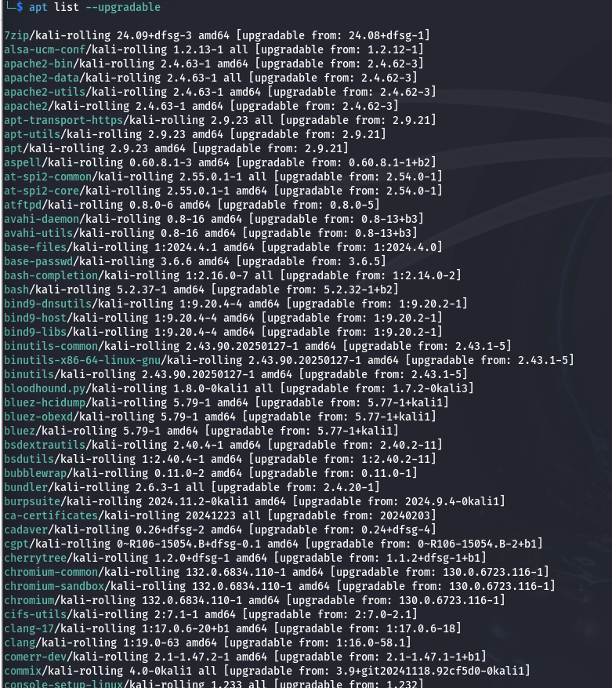
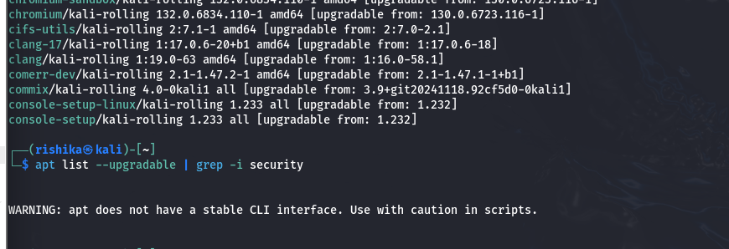
Linux Compliance
Linux Regulatory Requirement | Met/Not Met
Current on security updates | Met

Slide 25
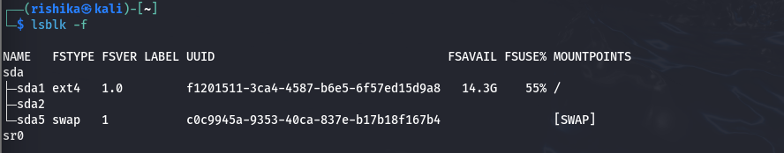
Linux Compliance
Linux Regulatory Requirement | Met/Not Met
Ensure separate partition exists for /var | Met

Slide 26

Linux Compliance
Linux Regulatory Requirement | Met/Not Met
Disable Automounting of drives | Met

Slide 27
Linux Compliance
Linux Regulatory Requirement | Met/Not Met
Ensure AIDE is installed | Met

Slide 28

Linux Compliance
Linux Regulatory Requirement | Met/Not Met
Ensure daytime services are not enabled | Met

Slide 29

Linux Compliance
Linux Regulatory Requirement | Met/Not Met
Ensure echo services are not enabled | Met

Slide 30

Linux Compliance
Linux Regulatory Requirement | Met/Not Met
Ensure tftp server is not enabled | Met

Slide 31

Linux Compliance
Linux Regulatory Requirement | Met/Not Met
Ensure CUPS is not enabled | Met

Slide 32

Linux Compliance
Linux Regulatory Requirement | Met/Not Met
Ensure DHCP Server is not enabled | Met

Slide 33
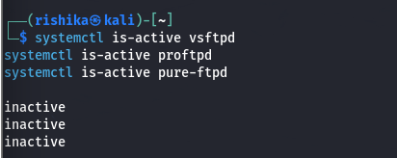
Linux Compliance
Linux Regulatory Requirement | Met/Not Met
Ensure FTP Server is not enabled | Met

Slide 34
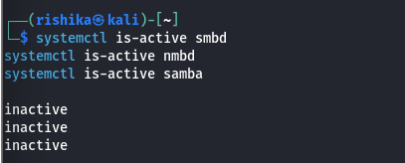
Linux Compliance
Linux Regulatory Requirement | Met/Not Met
Ensure Samba is not enabled | Met

Slide 35
Linux Compliance
Linux Regulatory Requirement | Met/Not Met
Ensure TCP Wrappers is installed | Met

Slide 36

Linux Compliance
Linux Regulatory Requirement | Met/Not Met
Ensure DCCP is disabled | Met

Slide 37
Linux Compliance
Linux Regulatory Requirement | Met/Not Met
Ensure iptables is installed | Met

Slide 38
Linux Compliance
Linux Regulatory Requirement | Met/Not Met
Ensure audit log storage size is configured | Met

Slide 39

Linux Compliance
Linux Regulatory Requirement | Met/Not Met
Ensure audit logs are not automatically deleted | Met

Slide 40
Section 4:
Cloud Management

Slide 41
Windows Server Build Sheet
As part of Fed F1rst Control Systems' security policy implementation, it is crucial to establish a standardized build process for Windows web servers hosted in the public cloud. A well-defined build sheet ensures consistency, security, and adherence to best practices across all server deployments. In this task, you will create a list of 10 essential items, along with examples, that should be included in a build sheet for a Windows web server hosted in the public cloud.
Identify 10 critical items that should be included in a build sheet for a Windows web server hosted in the public cloud
Provide a brief description OR an example for each item

Slide 42
Windows Server Build Sheet
1. Operating System & Version
Example: Windows Server 2022 Standard Specify the OS version and edition to ensure consistency and support compliance.
2. Security Patching & Updates
Example: Enable automatic Windows Updates and schedule security patching. Ensures the server remains protected against known vulnerabilities.
3. Web Server Software & Configuration
Example: Install and configure IIS (Internet Information Services). Define settings like binding, default document, and directory permissions.
4. Firewall & Network Security Settings
Example: Enable Windows Defender Firewall, restrict RDP to internal IPs, and configure security groups. Restricts unauthorized access while allowing necessary traffic.
5. Identity & Access Management (IAM)
Example: Disable local admin accounts and use Azure AD for authentication. Enforces least privilege access and centralized user management.

Slide 43
Windows Server Build Sheet
6. Secure Remote Access
Example: Enable RDP over VPN only and enforce Multi-Factor Authentication (MFA). Prevents unauthorized access and strengthens security.
7. SSL/TLS Certificate Installation
Example: Install an SSL certificate from a trusted CA and enforce HTTPS. Protects data in transit and ensures secure communication.
8. Logging & Monitoring Setup
Example: Enable Windows Event Logging, integrate with SIEM (e.g., Azure Sentinel). Tracks system activities for security audits and incident response.
9. Backup & Disaster Recovery
Example: Configure daily snapshots and offsite backups using Azure Backup. Ensures data availability and recovery in case of failure.
10. Hardening & Compliance Checks
Example: Disable unused services, enforce strong password policies, and follow CIS benchmarks. Reduces attack surface and ensures compliance with security standards.

Slide 44
Enhancing Cloud Security with CASB
With Fed F1rst Control Systems increasingly leveraging cloud technologies for their operations, the integration of Cloud Access Security Brokers (CASB) into their security framework is more crucial than ever. Given your understanding of CASBs from the course, you're in a unique position to assess how their capabilities can specifically enhance Fed F1rst's security posture.
Identify 5 specific benefits of CASBs that would directly enhance the cloud security posture of Fed F1rst Control Systems
Provide a concise, clear description for each benefit

Slide 45
Enhancing Cloud Security with CASB
1. Visibility into Cloud Usage
CASBs provide comprehensive visibility into all cloud applications being used within an organization, including both sanctioned and unsanctioned (shadow IT) applications. This visibility allows Fed F1rst to monitor cloud activities and ensure compliance with security policies.
2. Data Loss Prevention (DLP)
CASBs enable the enforcement of data protection policies to prevent sensitive data from being uploaded or accessed inappropriately in cloud environments. Fed F1rst can apply encryption, access control, and DLP policies to safeguard intellectual property and other sensitive information.
3. Threat Detection and Incident Response
By integrating threat intelligence, CASBs can detect anomalous behavior and potential security incidents, such as unauthorized access or data exfiltration. This enables Fed F1rst to respond quickly to threats, reducing the likelihood of a security breach or data loss.
4. Access Control and Identity Management
CASBs help enforce strong access control policies by integrating with identity management systems (like Single Sign-On and Multi-Factor Authentication). Fed F1rst can ensure that only authorized users and devices can access critical cloud resources, improving overall security.
5. Compliance Monitoring and Reporting
CASBs simplify compliance with regulations such as GDPR, HIPAA, and other industry standards by continuously monitoring cloud activities and generating audit trails. Fed F1rst can maintain regulatory compliance while avoiding penalties associated with non-compliance.

